Slide 1
Re-Opening Your Facility and Keeping It Open Safely During a Pandemic
Ari Rosner
Pandemic Analytics and
Richard Fiene
Research Institute for Key Indicators

Slide 2
The Problem
How to open your facility safely for children and adults via models for distancing & density.
How to keep groups of individuals safe over time by using Contact Hours.
How to do this within the context of a pandemic – COVID-19.

Slide 3
Potential Solution: Rosner & Fiene Models
Start with the Rosner Model to set up your space safely.
Total number of individuals and the available space.
Point and click data entry.
Web-based system.
Monitor the space over time with the Fiene Contact Hour Model.
Answer 6 basic questions about your facility.
Data can be drawn from existing data systems or entered manually.
Manual system with capability to become web-based system.

Slide 4
Rosner Model
Setting up your space
How can we maximize the spacing between people in any given space?
What is the optimal configuration? Where do we place each person?
How do we most effectively consider furniture and leave space for people to use the door?
How can we ensure that not only is there safe social distancing between students, but that the teachers are safe in the space as well?
Use the following link in order to download the software and enter your room information
https://www.pandemicanalytics.net

Slide 5
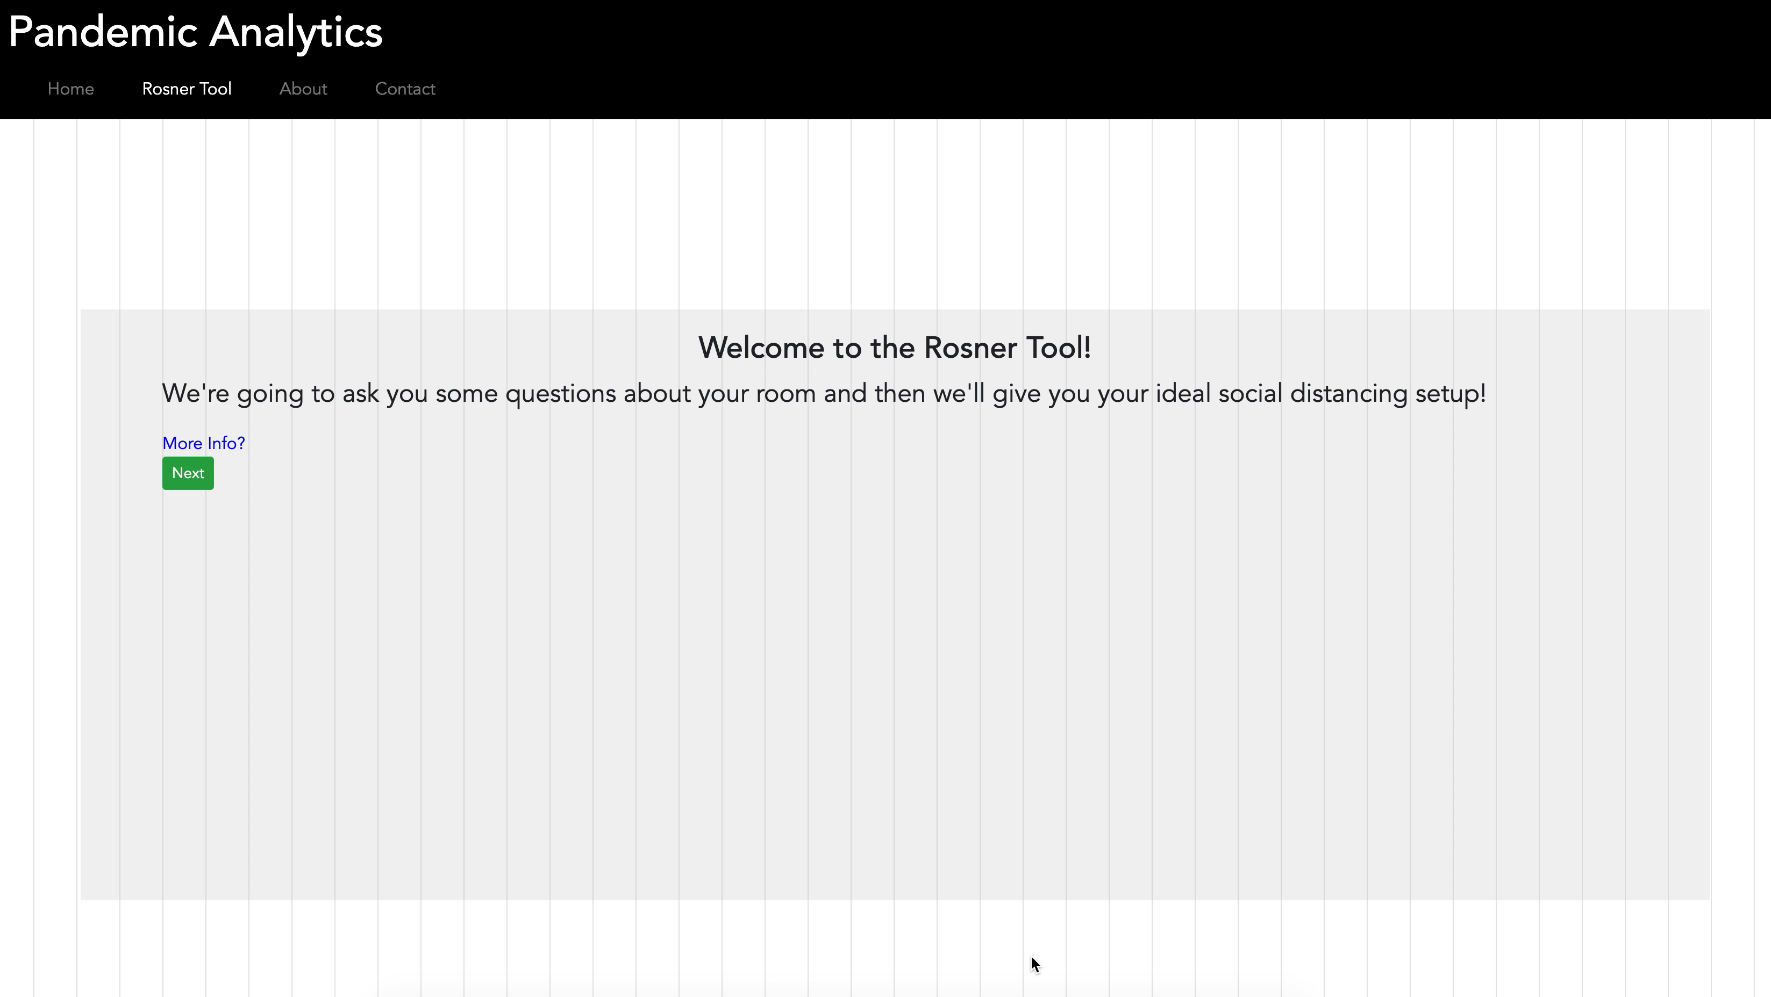
Room Spacing

Slide 6
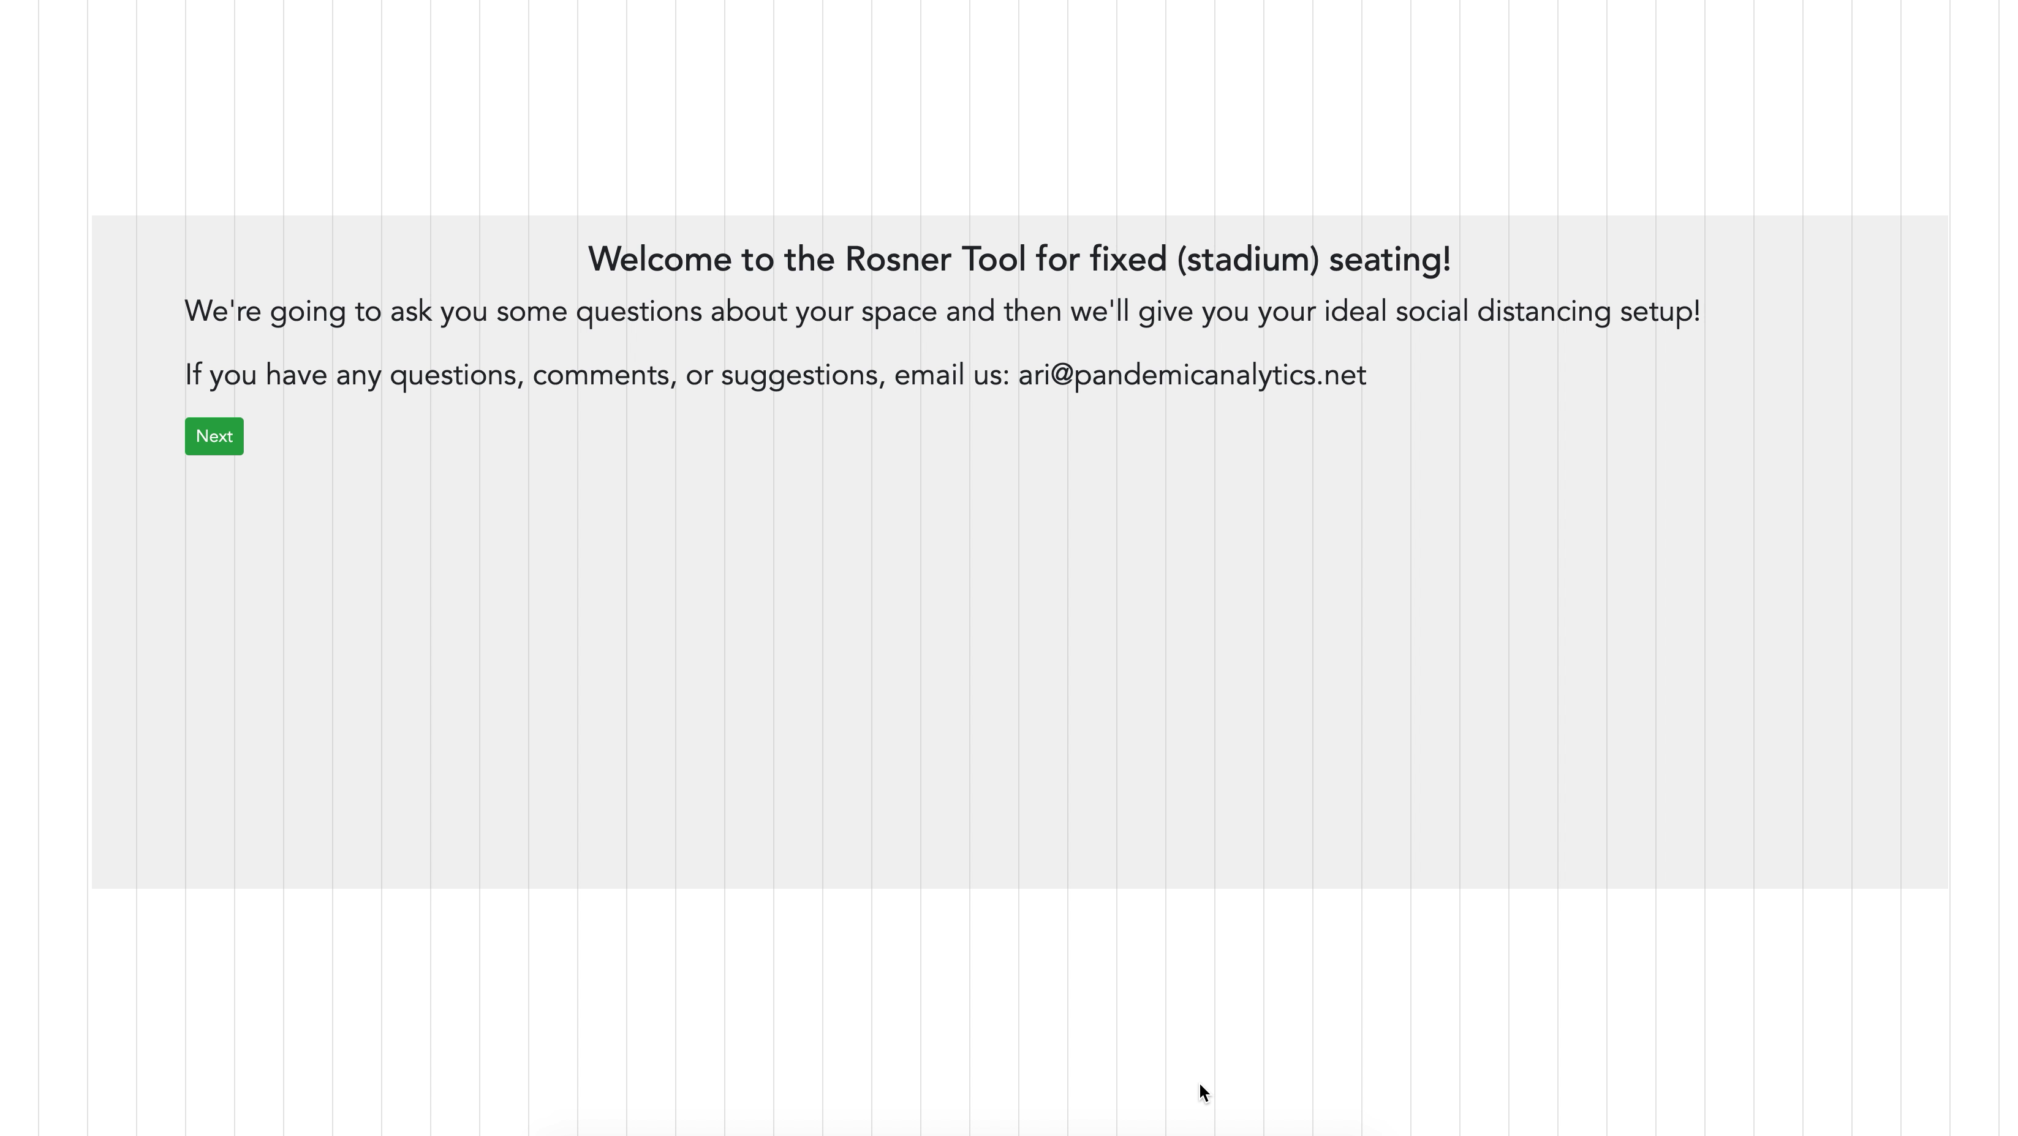
Fixed Seating (lecture hall, theater, stadium) Spacing

Slide 7
Fiene Model
Begin by answering the questions on the next slide. These questions should be answered daily.
Follow the algorithms.
Utilize the Conversion table.
Go to the following Website for additional information http://rikinstitute.com

Slide 8
Fiene Model: The Questions to Ask
When does your first teaching staff arrive or when does your facility open (TO1)?
When does your last teaching staff leave or when does your facility close (TO2)?
Number of teaching/caregiving staff (TA)?
Number of children on your maximum enrollment day (NC)?
When does your last child arrive (TH1)?
When does your first child leave (TH2)?

Slide 9
Fiene Model: The CH & RWCH Formula
(1) CH = (((NC (TO + TH)) / 2) / (TA)) / (SQFT) = RWCH;
(2) CH = ((NC x TO) / (TA)) / (SQFT) = RWCH;
(3) CH = (((NC x TO) / 2) / (TA)) / (SQFT) = RWCH;
(4) CH = ((NC²) / (TA)) / (SQFT) = RWCH
Where: CH = Contact Hours; RWCH = Relatively Weighted Contact Hours; NC = Number of Children; TO = Total number of hours the facility is open (TO2 - TO1); TA = Total number of teaching staff, and TH = Total number of hours at full enrollment (TH2 - TH1); SQFT = Square Feet.

Slide 10
Fiene Model: Contact Hour (CH)/Relatively Weighted Contact Hour (RWCH) Conversion Table
NC | CH | 1:1 | 2:1 | 3:1 | 4:1 | 5:1 | 6:1 | 7:1 | 8:1 | 9:1 | 10:1 | 11:1 | 12:1 | 13:1 | 14:1 | 15:1
1 | 8 | 8 | 8 | 8 | 8 | 8 | 8 | 8 | 8 | 8 | 8 | 8 | 8 | 8 | 8 | 8
2 | 16 | 8 | 16 | 16 | 16 | 16 | 16 | 16 | 16 | 16 | 16 | 16 | 16 | 16 | 16 | 16
3 | 24 | 8 | 12 | 24 | 24 | 24 | 24 | 24 | 24 | 24 | 24 | 24 | 24 | 24 | 24 | 24
4 | 32 | 8 | 16 | 16 | 32 | 32 | 32 | 32 | 32 | 32 | 32 | 32 | 32 | 32 | 32 | 32
5 | 40 | 8 | 13 | 20 | 20 | 40 | 40 | 40 | 40 | 40 | 40 | 40 | 40 | 40 | 40 | 40
6 | 48 | 8 | 16 | 24 | 24 | 24 | 48 | 48 | 48 | 48 | 48 | 48 | 48 | 48 | 48 | 48
7 | 56 | 8 | 14 | 19 | 28 | 28 | 28 | 56 | 56 | 56 | 56 | 56 | 56 | 56 | 56 | 56
8 | 64 | 8 | 16 | 21 | 32 | 32 | 32 | 32 | 64 | 64 | 64 | 64 | 64 | 64 | 64 | 64
9 | 72 | 8 | 14 | 24 | 24 | 36 | 36 | 36 | 36 | 72 | 72 | 72 | 72 | 72 | 72 | 72
10 | 80 | 8 | 16 | 20 | 27 | 40 | 40 | 40 | 40 | 40 | 80 | 80 | 80 | 80 | 80 | 80
11 | 88 | 8 | 15 | 22 | 29 | 29 | 44 | 44 | 44 | 44 | 44 | 88 | 88 | 88 | 88 | 88
12 | 96 | 8 | 16 | 24 | 32 | 32 | 48 | 48 | 48 | 48 | 48 | 48 | 96 | 96 | 96 | 96
13 | 104 | 8 | 15 | 21 | 26 | 35 | 35 | 52 | 52 | 52 | 52 | 52 | 52 | 104 | 104 | 104
14 | 112 | 8 | 16 | 22 | 28 | 37 | 37 | 56 | 56 | 56 | 56 | 56 | 56 | 56 | 112 | 112
15 | 120 | 8 | 15 | 24 | 30 | 40 | 40 | 40 | 60 | 60 | 60 | 60 | 60 | 60 | 60 | 120
16 | 128 | 8 | 16 | 21 | 32 | 32 | 43 | 43 | 64 | 64 | 64 | 64 | 64 | 64 | 64 | 64
17 | 136 | 8 | 15 | 23 | 27 | 34 | 45 | 45 | 45 | 68 | 68 | 68 | 68 | 68 | 68 | 68
18 | 144 | 8 | 16 | 24 | 29 | 36 | 48 | 48 | 48 | 72 | 72 | 72 | 72 | 72 | 72 | 72
19 | 152 | 8 | 15 | 22 | 30 | 38 | 38 | 51 | 51 | 51 | 76 | 76 | 76 | 76 | 76 | 76
20 | 160 | 8 | 16 | 23 | 32 | 40 | 40 | 53 | 53 | 53 | 80 | 80 | 80 | 80 | 80 | 80
21 | 168 | 8 | 15 | 24 | 28 | 34 | 42 | 56 | 56 | 56 | 56 | 84 | 84 | 84 | 84 | 84
22 | 176 | 8 | 16 | 22 | 29 | 35 | 44 | 44 | 59 | 59 | 59 | 88 | 88 | 88 | 88 | 88
23 | 184 | 8 | 15 | 23 | 31 | 37 | 46 | 46 | 61 | 61 | 61 | 61 | 92 | 92 | 92 | 92
24 | 192 | 8 | 16 | 24 | 32 | 38 | 48 | 48 | 64 | 64 | 64 | 64 | 96 | 96 | 96 | 96
25 | 200 | 8 | 15 | 22 | 29 | 40 | 40 | 50 | 50 | 67 | 67 | 67 | 67 | 100 | 100 | 100
26 | 208 | 8 | 16 | 23 | 30 | 35 | 42 | 52 | 52 | 69 | 69 | 69 | 69 | 104 | 104 | 104
27 | 216 | 8 | 15 | 24 | 31 | 36 | 43 | 54 | 54 | 72 | 72 | 72 | 72 | 72 | 108 | 108
28 | 224 | 8 | 16 | 22 | 32 | 37 | 45 | 56 | 56 | 56 | 75 | 75 | 75 | 75 | 112 | 112
29 | 232 | 8 | 15 | 23 | 29 | 39 | 46 | 46 | 58 | 58 | 77 | 77 | 77 | 77 | 77 | 116
30 | 240 | 8 | 16 | 24 | 30 | 40 | 48 | 48 | 60 | 60 | 80 | 80 | 80 | 80 | 80 | 120

Slide 11
Conclusion
With the use of these two models, there is no guarantee that you will be able to prevent the spread of the virus, but you should be able to mitigate the spread through a scientific and data driven approach to distancing in setting up a space and maintaining it over time.
These models will provide cost effective and efficient approaches to space allocation and interaction.

Slide 12
Additional Information:
Ari Rosner
Pandemic Analytics
Ari@pandemicanalytics.net
Richard Fiene, Ph.D.
Research Institute for Key Indicators
RFiene@RIKInstitute.com

